Slide 1
MVC Design Pattern
Understanding Modern Web Application Architecture

Slide 2
What Are Design Patterns?
Reusable solutions to common programming problems
Not algorithms → conceptual templates
Improve code organization, maintainability, and scalability
Widely used in software engineering across languages and frameworks

Slide 3
Why Do We Need Design Patterns?
Prevent repeating the same structural mistakes
Bring consistency across large codebases and teams
Make code easier to maintain, test, and extend
Enable developers to communicate using common terminology
Provide time-tested solutions to recurring problems

Slide 4
Simple Examples of Design Patterns
Singleton → Only one instance (e.g., a global database connection)
Factory → Creates objects without exposing creation logic
Observer → One object reacts to changes in another (e.g., UI updates)
Strategy → Swap algorithms at runtime (e.g., sorting strategies)

Slide 5
Introduction to MVC
MVC = Model – View – Controller
Separates:
  Data
  User interface
  Application logic
Originated in GUI applications
Foundation of most modern web frameworks

Slide 6
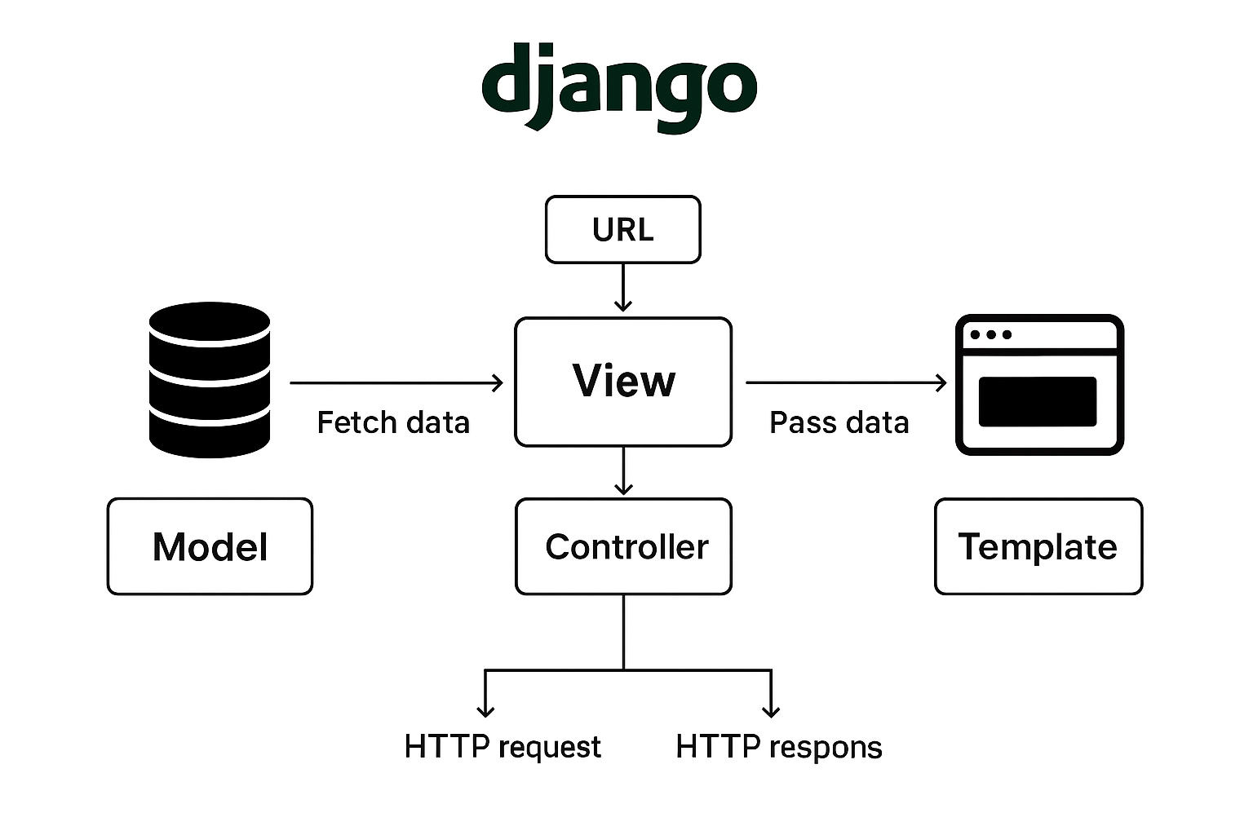

Slide 7
Why MVC Was a Revolution
Early web = HTML + CSS + JS mixed together
Hard to maintain, scale, or collaborate on
MVC brought separation of concerns
Enabled large teams and complex applications

Slide 8
The Model
Represents the data behind the application
Manages:
  Data structure
  Validation rules
  Reading/writing to storage
Could be:
  Database (SQL/NoSQL)
  Files
  Remote API
Independent from UI

Slide 9
The View
The presentation layer
Displays data from the Model
Technologies: HTML, CSS, JavaScript, templates
Different views for different users (tables, charts, maps)
Contains no business logic

Slide 10
The Controller
Acts as the middleman between Model & View
Handles user input
Calls the Model to get/update data
Passes data to the View
Implements the business logic of the application

Slide 11
MVC Workflow
User interacts with the interface
Controller processes the request
Controller gets data from the Model
Controller passes data to the View
View renders updated UI

Slide 12
Why MVC Matters
Separation of concerns
Easier maintenance and debugging
Cleaner code structure
Reusable components
Team members can specialize (View devs, DB devs, Backend devs)

Slide 13
Real-World Examples
Django (MVT) → Template ~ View, View ~
Ruby on Rails → Classic MVC
Laravel (PHP) → MVC
Spring Boot (Java) → Often MVC + Service Layer
ASP.NET MVC → Strong MVC architecture

Slide 14
Variations in Naming
MVC is a concept, implementation varies
Django views ≠ Pure MVC views
Spring adds Service layer
Some frameworks merge controller + view logic
Core principle remains: separation of concerns

Slide 15
Implementing MVC (Generally)
Organize code into three distinct layers
Models = data logic
Controllers = business logic + routing
Views = display logic
Any language can implement MVC (Python, Java, JS runtime, PHP)

Slide 16
Summary
MVC separates Model, View, Controller
Encourages clarity, organization, maintainability
Powers most modern web frameworks
Critical foundation for scalable application development

